Slide 1
site
x_coord
Software House
(0,n)
Located
In
(1,1)
City
(0,n)
HasCountry
(1,1)
Country
y_coord
name
name
name
Developer
Publisher
Console
(1,n)
us
cs
platform
name
(1,1)
(1,1)
name
Released For
Develop
Publish
genre
title
sales
earn
players
#event
year
(1,n)
Tournament
Videogame
(1,n)
(1,n)
date
(1,n)
MadeTournament
eSport
(1,n)
TotEarn
OnErn
title

Slide 2
Metacritic
Metacritic is a website that aggregates reviews and averaged scores for films, TV shows, music albums, video games and formerly, books.
metacritic (json)
This dataset stresses out the averaged user score and the metacritic score for each game of the dataset.
id | title | us | ms | platform | release
datagenreX (json)
id | genre
Moreover, in order to retrieve the genres of videogames, metacritic offered 16 different json files (based on 16 different genres)
datagenreX (json)
Note: the table representation is a normalized abstraction of the json dataset.

Slide 3
Metacritic
{
"1.":{
"title":"The Legend of Zelda: Ocarina of Time",
"us":"9.1",
"ms":"99",
"platform":"Nintendo 64",
"release":"November 23, 1998"
},
"2.":{
"title":"Tony Hawk's Pro Skater 2",
"us":"7.4",
"ms":"98",
"platform":"PlayStation",
"release":"September 20, 2000"
},
"3.":{
"title":"Grand Theft Auto IV",
"us":"7.7",
"ms":"98",
"platform":"PlayStation 3",
"release":"April 29, 2008"
},
"4.":{
"title":"SoulCalibur",
"us":"8.5",
"ms":"98",
"platform":"Dreamcast",
"release":"September 8, 1999"
},
"5.":{
"title":"Grand Theft Auto IV",
"us":"7.9",
"ms":"98",
"platform":"Xbox 360",
"release":"April 29, 2008"

Slide 4
Relational Schema
SoftwareHouse(name,site)
City(name)
LocatedIn(softwarehouse, city, x_coord, y_coord)
LocatedIn(softwarehouse) → SoftwareHouse(name)
LocatedIn(city) → City(name)
Country (name)
HasCountry(city, country)
HasCountry(country) → Country(name)
HasCountry(city) → City(name)
Videogame(title, genre)
Console(platform)
ReleasedFor(game, console,us,cs,sales,year)
ReleasedFor(game) → Videogame(title)
ReleasedFor(console) → Console(platform)
Developer(name)
Developer(name) → SoftwareHouse(name)
Publisher(name)
Publisher(name) → SoftwareHouse(name)
Publish(publisher,game)
Publish(publisher) → Publisher(name)
Publish(game) → Videogame(title)
Develop(developer,game)
Develop(developer) → Developer(name)
Develop(game) → Videogame(title)
eSport(title,TotalEarnings,OnlineEarnings)
eSport(title) → Videogame(title)
Tournament(date,game,earnings,#pricedplayers,#event)
Tournament(game) → eSport(title)

Slide 5
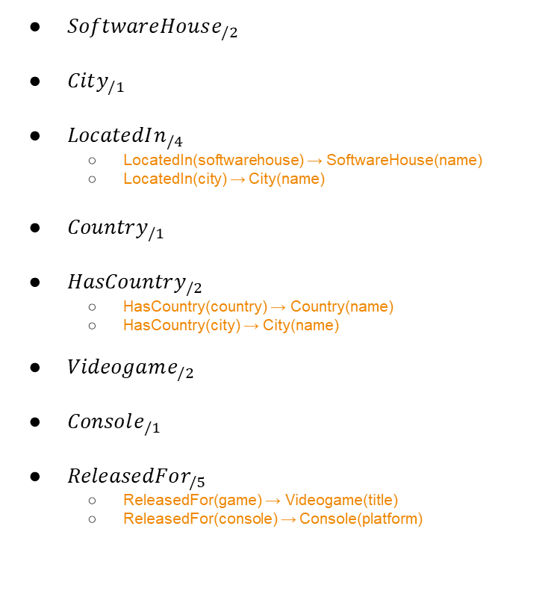
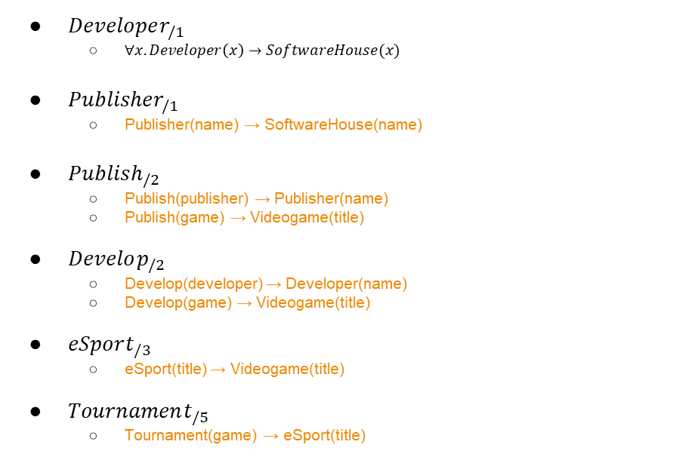
Global Schema
$SoftwareHouse_{/2}$
$City_{/1}$
$LocatedIn_{/4}$
LocatedIn(softwarehouse) → SoftwareHouse(name)
LocatedIn(city) → City(name)
$Country_{/1}$
$HasCountry_{/2}$
HasCountry(country) → Country(name)
HasCountry(city) → City(name)
$Videogame_{/2}$
$Console_{/1}$
$ReleasedFor_{/5}$
ReleasedFor(game) → Videogame(title)
ReleasedFor(console) → Console(platform)
$Developer_{/1}$
$∀x.Developer\left(x\right)→SoftwareHouse(x)$
$Publisher_{/1}$
Publisher(name) → SoftwareHouse(name)
$Publish_{/2}$
Publish(publisher) → Publisher(name)
Publish(game) → Videogame(title)
$Develop_{/2}$
Develop(developer) → Developer(name)
Develop(game) → Videogame(title)
$eSport_{/3}$
eSport(title) → Videogame(title)
$Tournament_{/5}$
Tournament(game) → eSport(title)

